Slide 1


FINAL PROJECT
Brazilian E-Commerce Olist Sentiment Analysis
Job Connector Data Science Video Learning
BY ALPHA TEAM
ALFIAN (JCDSVL-005-013)
OWEN AGITZA (JCDSVL-005-049)

Slide 2

PROFILE GROUP INTRO
FINAL PROJECT
Brazilian E-Commerce Public Dataset by Olist
Job Connector Data Science Video Learning
ALPHA TEAM
ALFIAN (JCDSVL-005-013)
OWEN AGITZA (JCDSVL-005-049)

Slide 3


INTRODUCTION
Alfian
Civil Engineering Graduate
Previously working as Jr. BIM Engineer
Owen Agitza Jaya
Food Technology Graduate
Previously working as packaging R&D

Slide 4
PROBLEM FORMULATION
FINAL PROJECT
Brazilian E-Commerce Public Dataset by Olist
Job Connector Data Science Video Learning
ALPHA TEAM
ALFIAN (JCDSVL-005-013)
OWEN AGITZA (JCDSVL-005-049)

Slide 5



Slide 6

BUSINESS UNDERSTANDING
GETTING TO KNOW OLIST
Brazilian marketplace integrator that operates in e-commerce sector
Offers a marketplace solution to shopkeepers of all sizes to whether they have online presence or not
Connects small businesses to larger product marketplaces to help entrepreneurs sell their products to a larger customer base

Slide 7

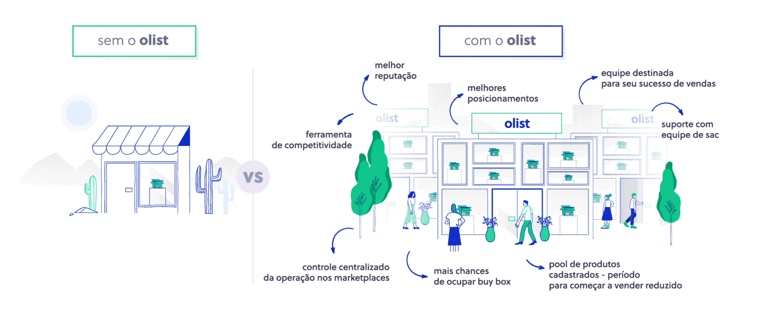
BUSINESS UNDERSTANDING
GETTING TO KNOW OLIST

Slide 8



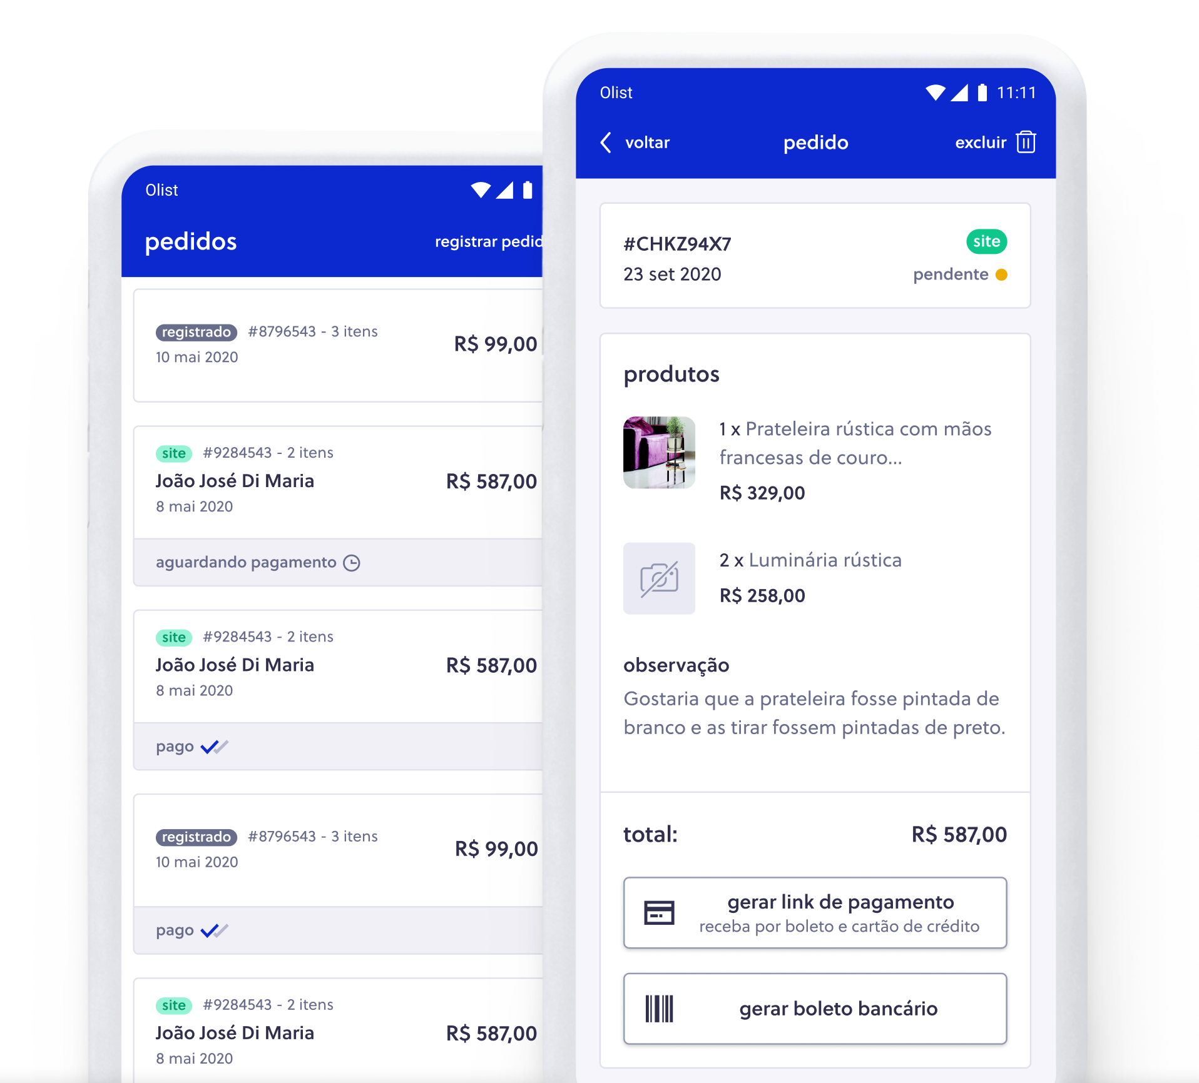
BUSINESS UNDERSTANDING
WHY SENTIMENT ANALYSIS?
Abundant
Given freely
CUSTOMERS
REVIEWS
Captures feedback

Slide 9


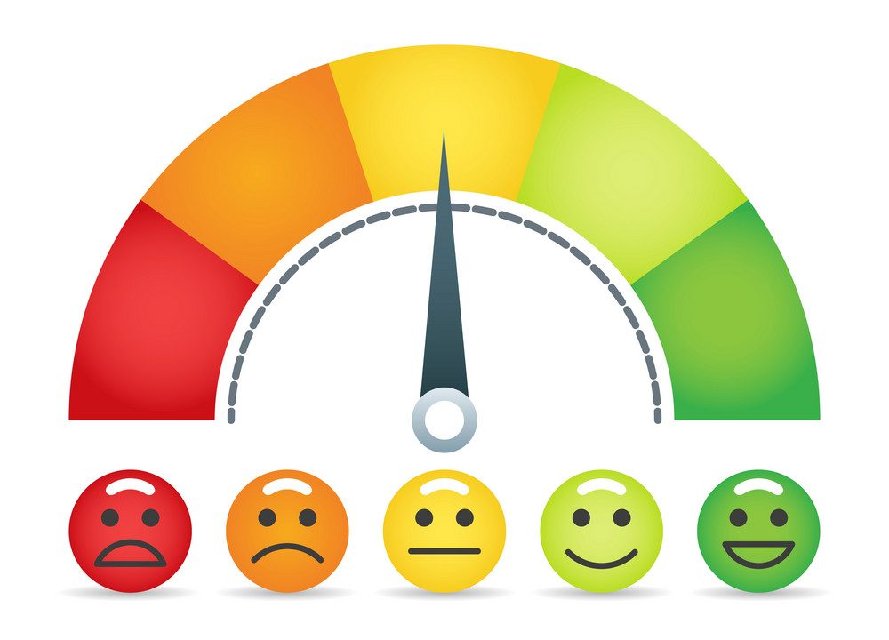
SENTIMENT ANALYSIS
SENTIMENT
AUTOMATION
INSIGHTS
Makes grasping the overall customer’s sentiment snapshot in an instant.
Automatically sorts the customer sentiment with minimal human intervention. Integrated with the system.
Derives insight such as what factors are the most important in customer’s sentiment.

Slide 10
BUSINESS UNDERSTANDING
OBJECTIVES
Olist wants to develop a model that could sort through thousands of reviews and grasp the overall sentiment of customers in an instance
Olist wants to know the overall sentiment of customer reviews and what terms are found in both good and bad reviews
Olist wants to know the model impact and what actions should be taken given the result of the sentiment analysis

Slide 11
DATA UNDERSTANDING
FINAL PROJECT
Brazilian E-Commerce Public Dataset by Olist
Job Connector Data Science Video Learning
ALPHA TEAM
ALFIAN (JCDSVL-005-013)
OWEN AGITZA (JCDSVL-005-049)

Slide 12
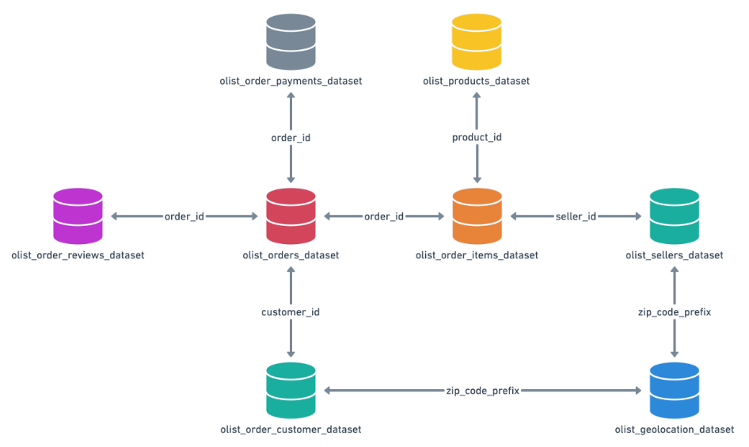
DATA RELATIONSHIP
BRAZILIAN E-COMMERCE PUBLIC DATASET BY OLIST
CORE
Sources : https://www.kaggle.com/datasets/olistbr/brazilian-ecommerce

Slide 13
DATA UNDERSTANDING
BRAZILIAN E-COMMERCE PUBLIC DATASET BY OLIST
df_orders
df_order_items
df_products
df_customers
order_id
custumer_id
order_status
order_purchase_timestamp
order_approved_at
order_delivered_carrier_date
order_delivered_customer_date
order_estimated_delivery_date
order_id
order_item_id
product_id
seller_id
shipping_limit_date
price
freight_value
product_id
product_category_name
product_name_lenght
product_description_lenght
product_photos_qty
product_weight_g
product_length_cm
product_height_cm
product_width_cm
customer_id
customer_unique_id
customer_zip_code_prefix
customer_city
customer_state
order_id is not unique, 1 order_id can contain multiple product_id
Total (price + freight_value) equals to total payment_value on df_payments
Only got category_name, not product_name, get product_id instead.
df_payments
df_reviews
df_sellers
df_geolocation
order_id
payment_sequential
payment_type
payment_installments
payment_value
review_id
order_id
review_score
review_coment_title
review_comment_message
review_creation_date
review_answer_timestamp
seller_id
seller_zip_code_prefix
seller_city
seller_state
geolocation_zip_code_prefix
geolocation_lat
geolocation_lng
geolocation_city
geolocation_state
order_id is not unique, 1 order_id can contain multiple row of data containing payment sequence to fully paid 1 order_id
1 order_id can be paid with 2 payment_type (inst. Credit card & debit)
1 order_id can contain 3 diff. review_id, 3 diff. review_comment_message
1 review_id can contain 3 diff. order_id, but same review_comment_message

Slide 14
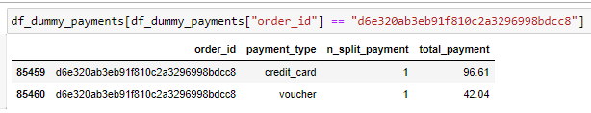
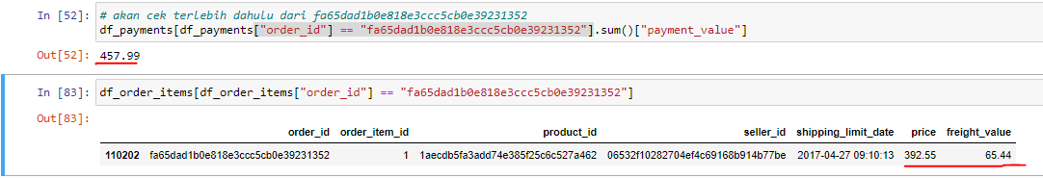
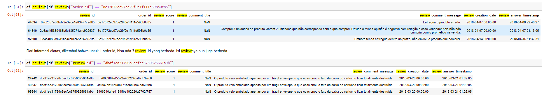
df_payments
1 order_id can be paid with 2 payment_type (inst. Credit card & debit)
Total (price + freight_value) in df_order_item equals to total payment_value in df_payments or vice versa
df_reviews
1 order_id can contain 3 diff. review_id, 3 diff. review_comment_message
1 review_id can contain 3 diff. order_id, but same review_comment_message

Slide 15
FINDINGS & SOLUTION
FINAL PROJECT
Brazilian E-Commerce Public Dataset by Olist
Job Connector Data Science Video Learning
ALPHA TEAM
ALFIAN (JCDSVL-005-013)
OWEN AGITZA (JCDSVL-005-049)

Slide 16
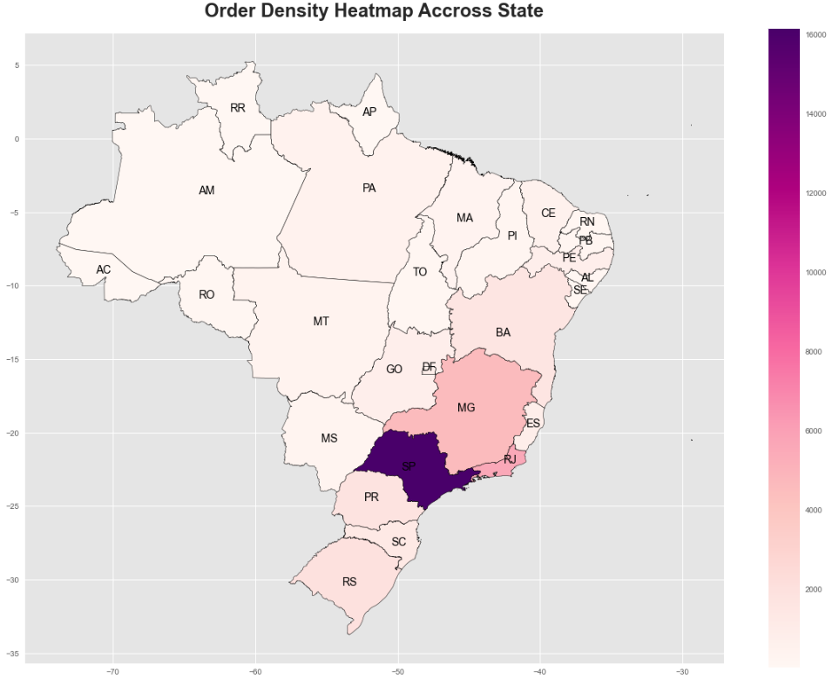
FINDINGS & SOLUTION
ORDER DENSITY
The southern part of Brazil has more order density then all the other parts
With the most being San Paulo (SP, 40.48 %), Rio de Janeiro (RJ, 13.97%), and Minas Gerais (MG, 11.56%), etc.
The northern part of Brazil only constitutes for about 7.71%, which is relatively low

Slide 17
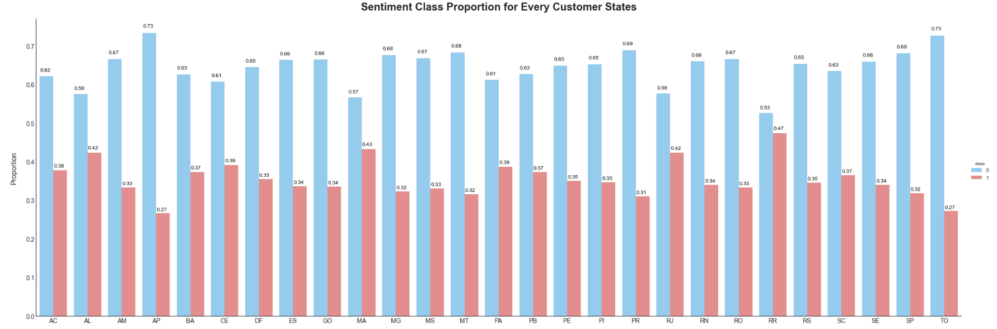
FINDINGS & SOLUTION
OVERALL SENTIMENT
Almost all customer states have a good proportion of positive sentiments (> 60%) except for AL, MA, RJ, and RR
The customer states with the highest proportion of positive sentiments are AP, TO, and PR
Olist has done a remarkable performing their business such that the majority of customer state are classified to have positive sentiment class

Slide 18
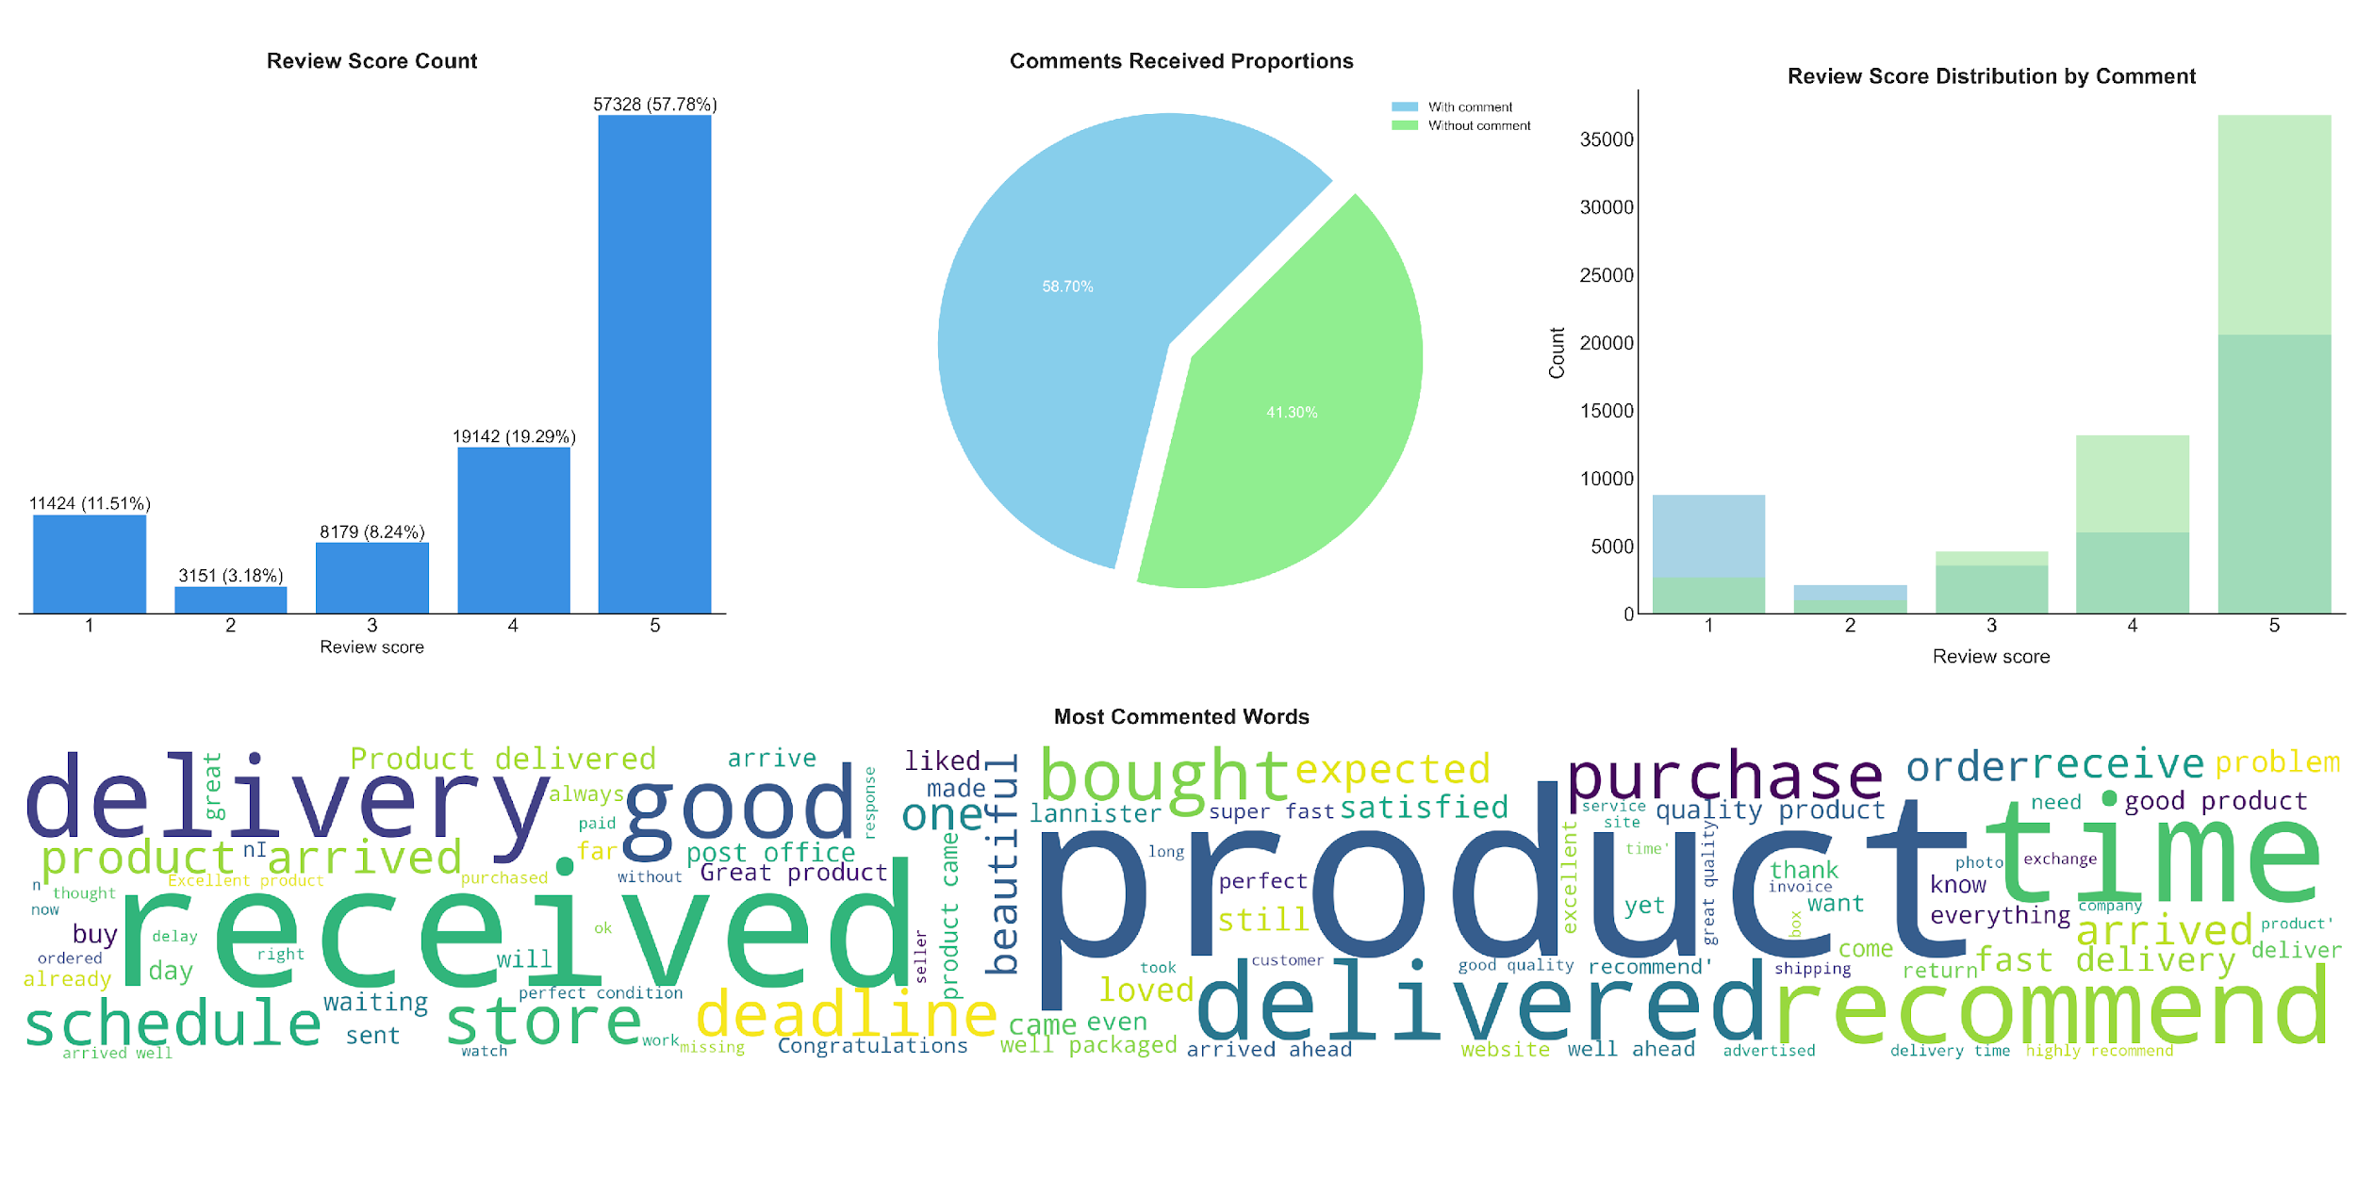
FINDINGS & SOLUTION
REVIEWS
58.70%
41.30%
Reviews are dominated with the score 5 (57.78%), followed by 4 (18.29%), and 1 (11.51%), while 3 and 2 only constitutes for < 12%
Over 58.70% orders received comments while the rest do not (41.30%)
At a glance, it seems like orders without comment have a larger proportion of high review scores (4, 5) and smaller proportion of low review scores (1, 2)
The snapshot of most commented words revolves around the terms product, received, delivery, time, and recommend

Slide 19
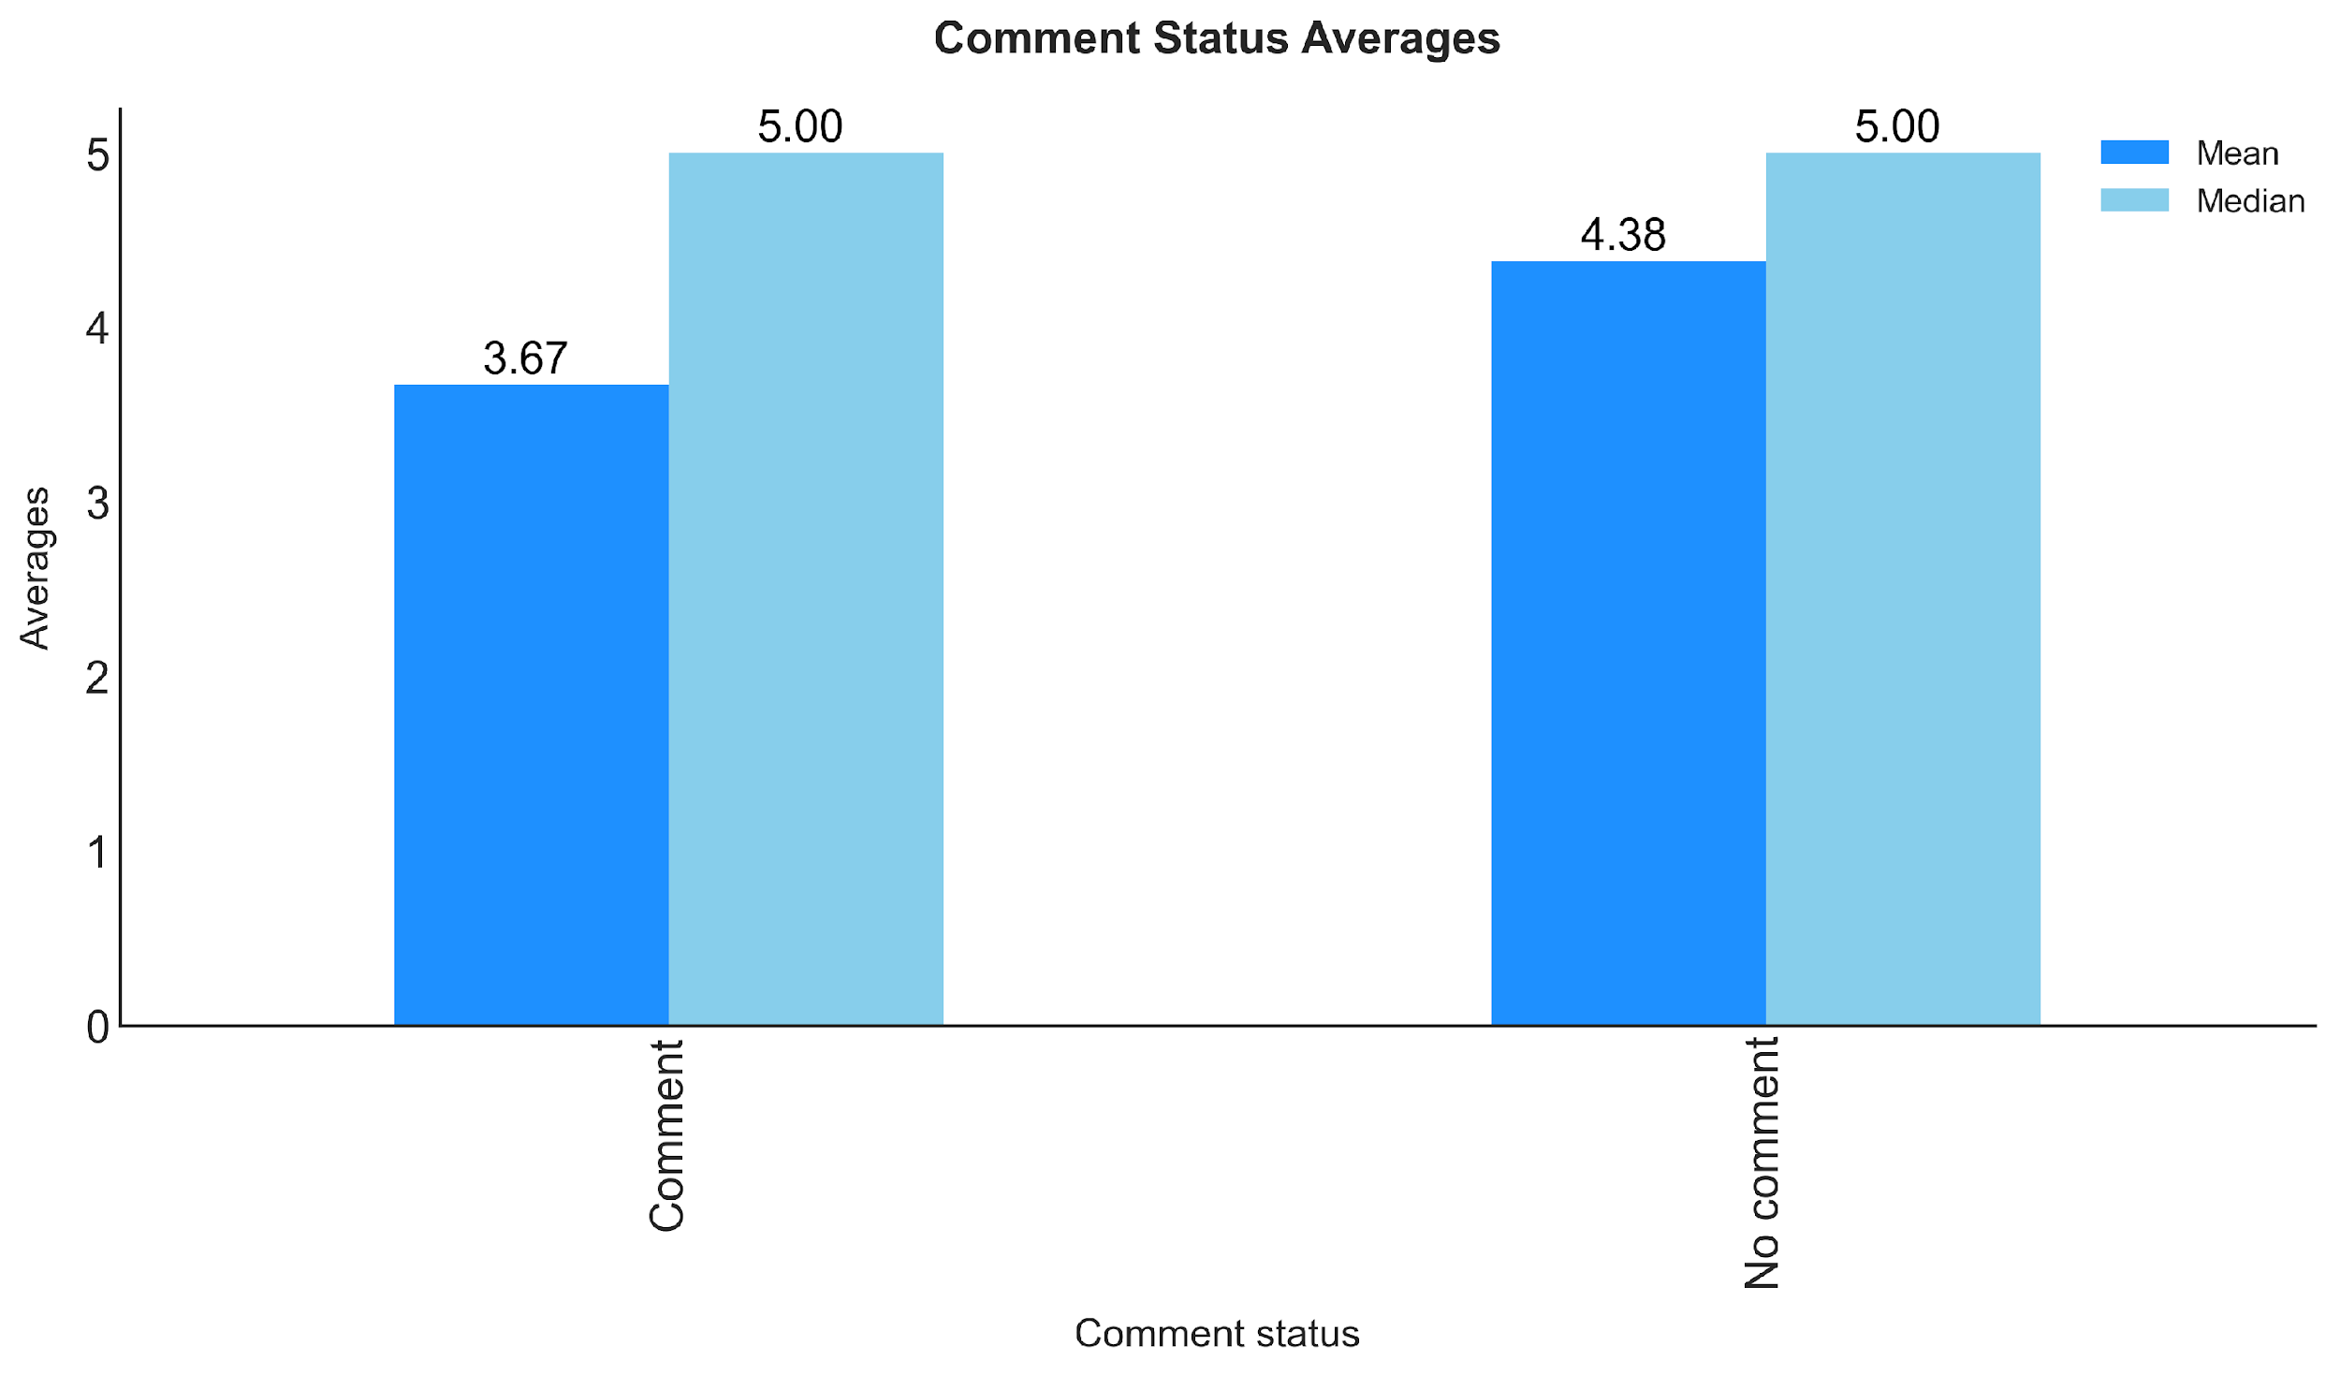
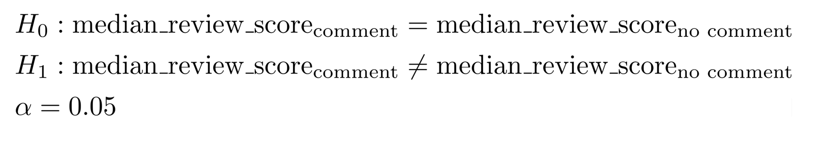
FINDINGS & SOLUTION
REVIEWS
The median review score of orders with comment ordered is different than median review score of orders without comment
Hence, customers that do not comment might have a give statistically different review score than those who do
The sample averages showed that no comment group has higher mean (4.38) than comment group (3.67)

Slide 20
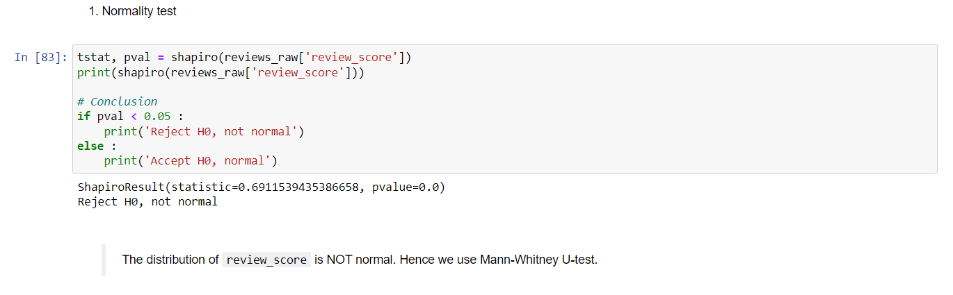
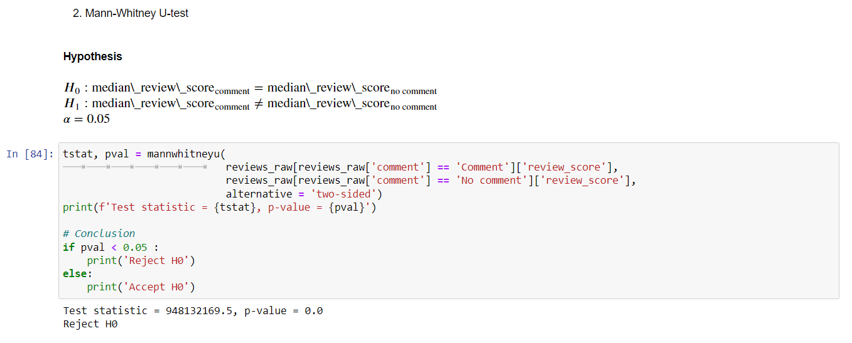

Slide 21
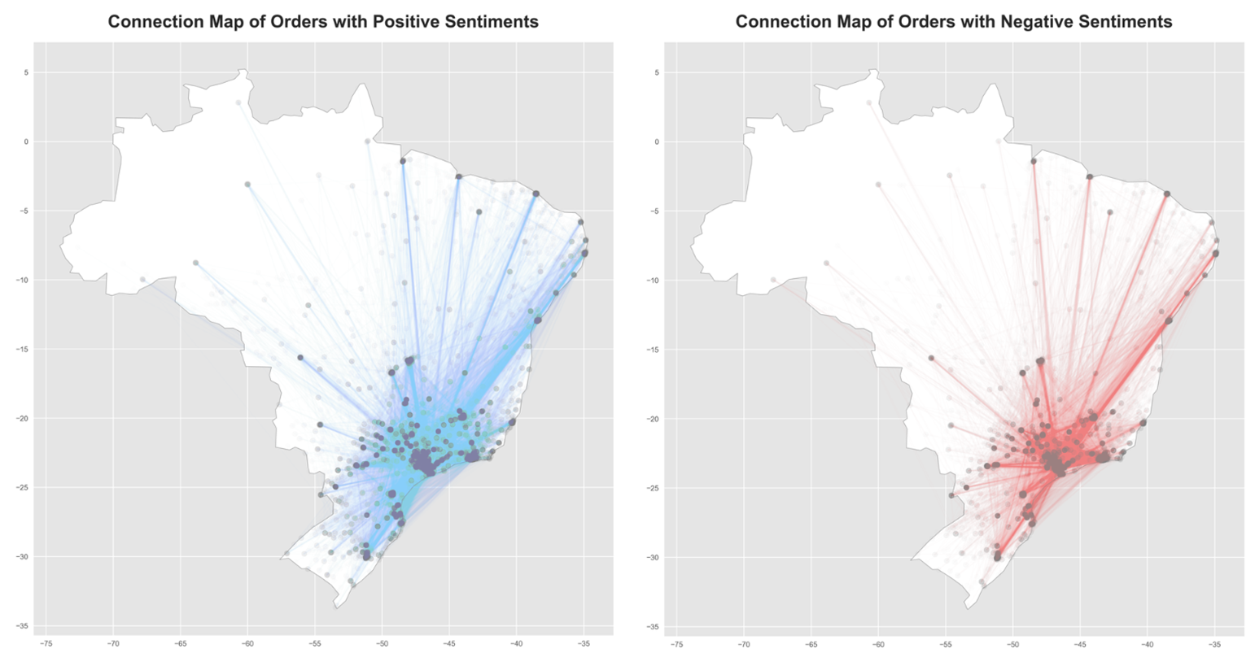
FINDINGS & SOLUTION
DISTANCE
From these 2 charts, there seems to be no difference in customer sentiments in terms of delivery path (i.e. distance)
This suggests that in the end, distance may not play part in the overall customer sentiment, as long as the delivery process is under control

Slide 22
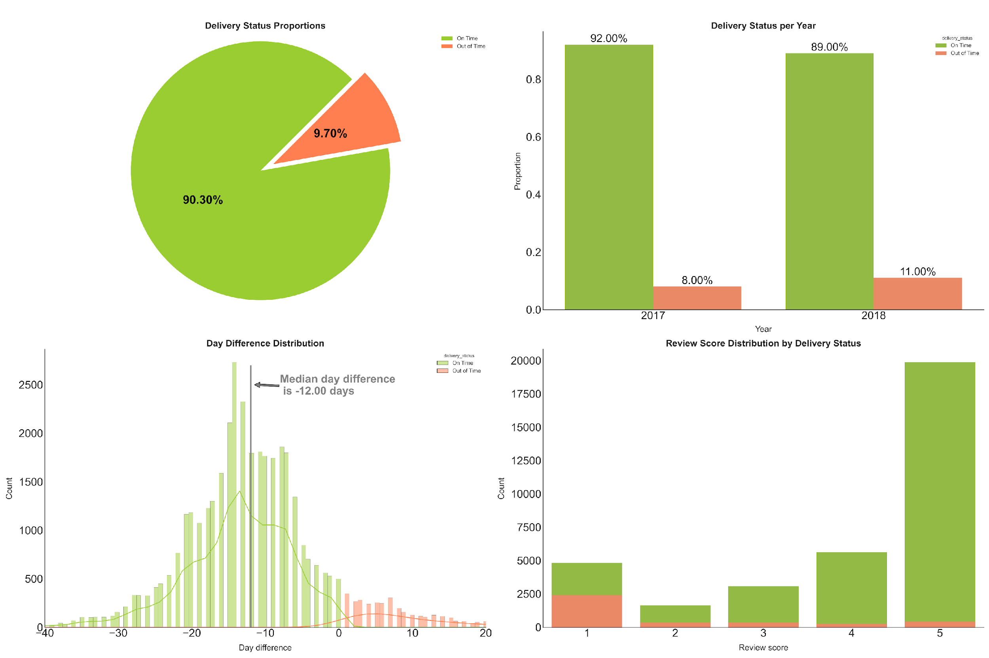
FINDINGS & SOLUTION
DELIVERY STATUS
Over 90.30% orders are delivered on time while a small fraction of orders are out of time (9.70%)
The performance of delivery status underwent a slight decrease from 92% (2017) → 89% (2018)
Overall, the day difference distribution is good, in which the median score for day difference is at -12 days
At a glance, it seems like on time deliveries have a larger proportion of high review scores (4, 5) and smaller proportion of low review scores (1, 2). Meanwhile, out of time deliveries have a large proportion of low review score (1) only

Slide 23
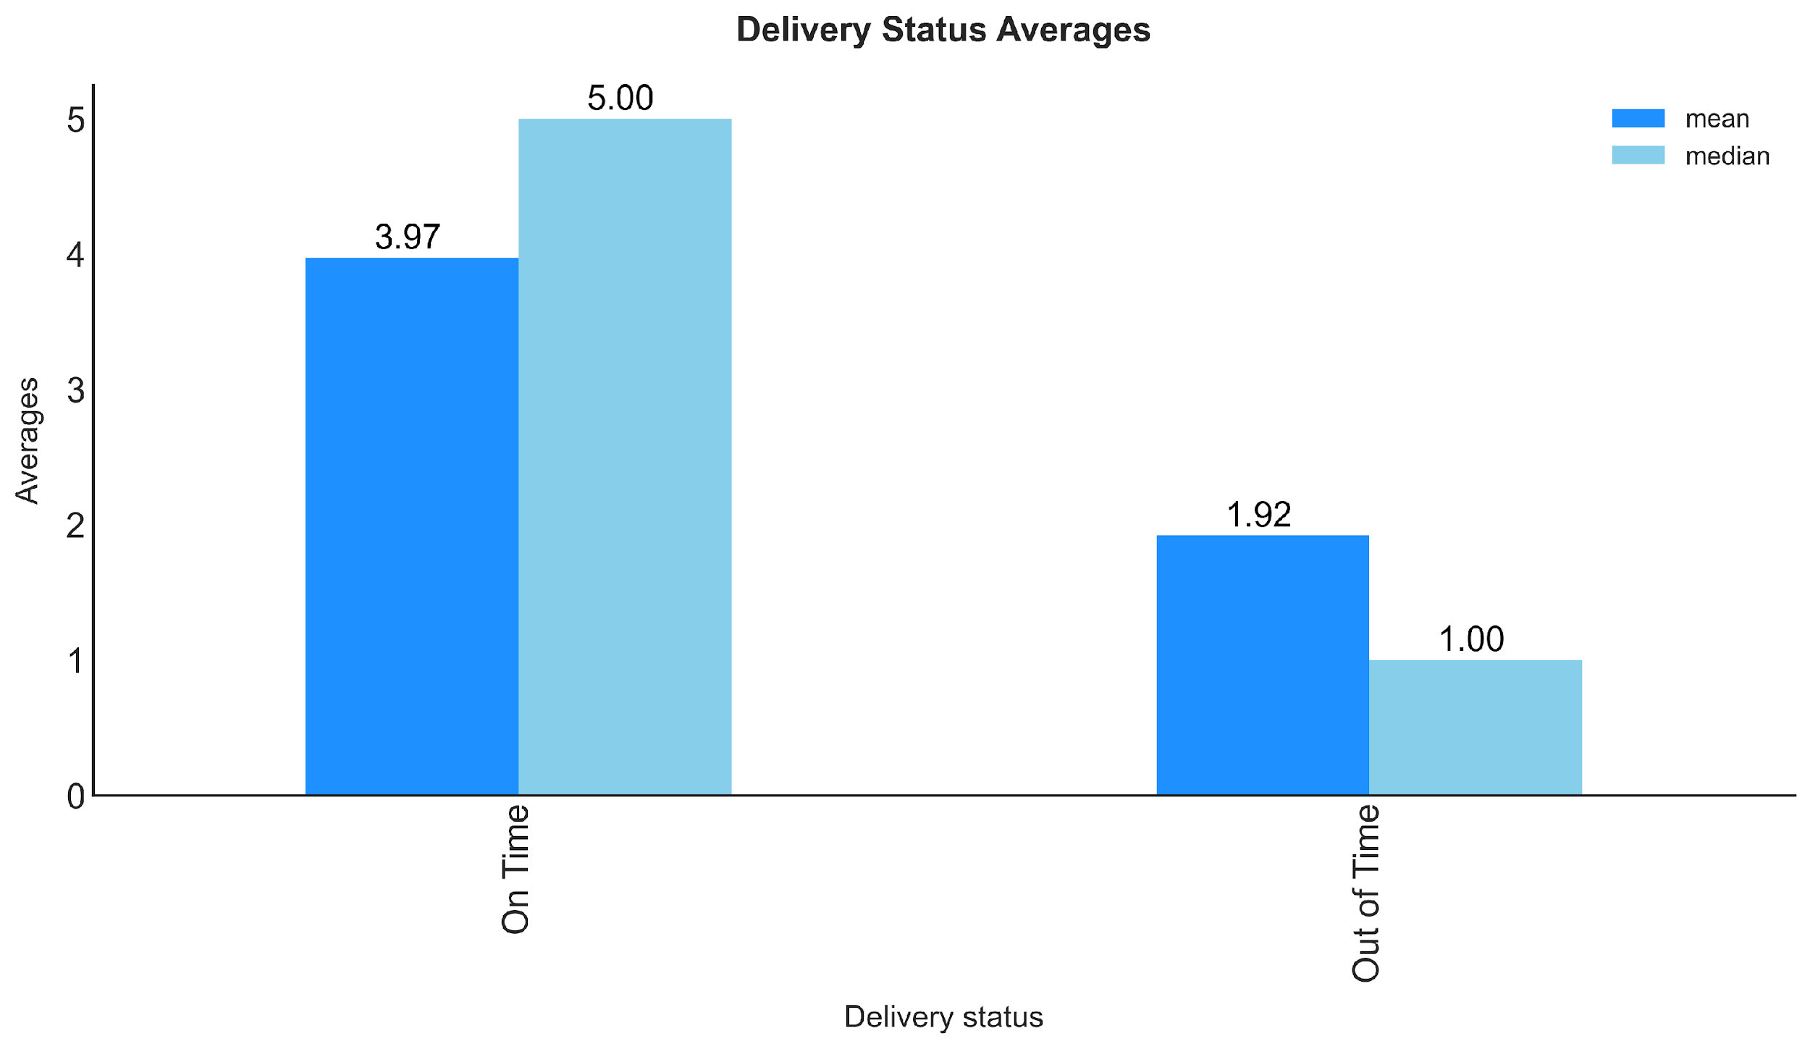
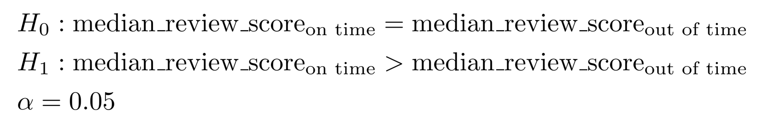
FINDINGS & SOLUTION
DELIVERY STATUS
The median review score of on time deliveries is larger than median review score of out of time deliveries
Hence, so far, delivery timeliness is the biggest factor for determining customer review score and overall satisfaction
The sample averages showed that on time group has higher mean (3.97) and median (5.00) than comment group (1.92; 1.00)

Slide 24
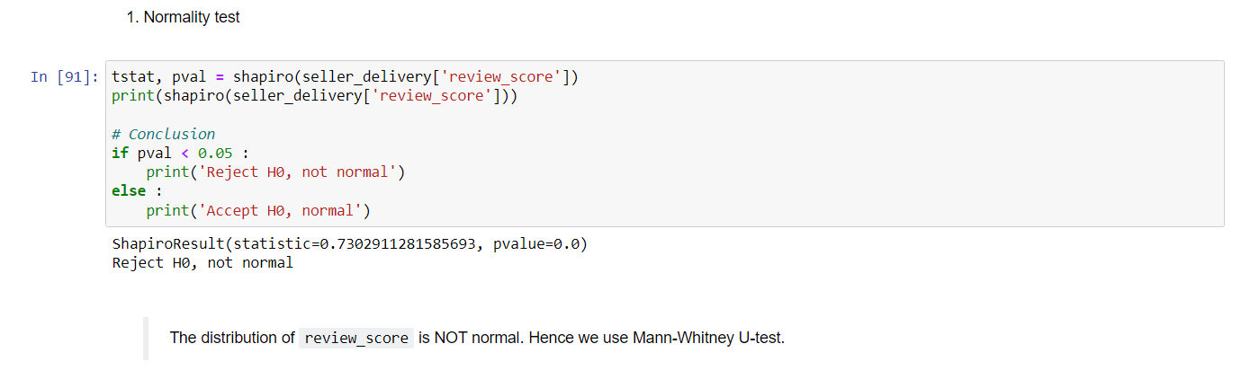
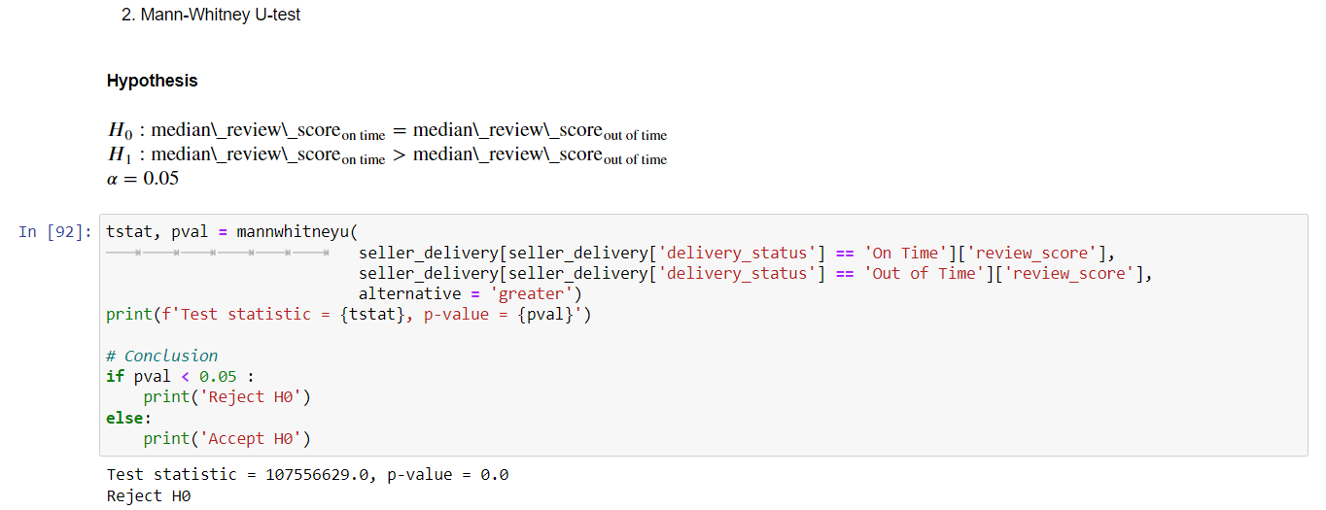

Slide 25
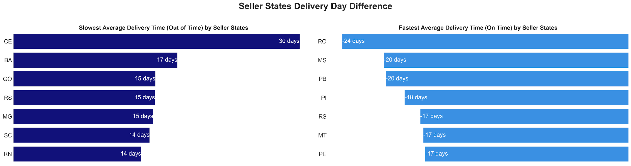
FINDINGS & SOLUTION
DELIVERY DAY DIFFERENCE BY SELLER STATES
The graph above shows the performance of individual seller states in both out of time and on time deliveries
The most extreme states are CE at the average of 30 days late, and RO at -24 days earlier
Keep in mind that this chart is produced by splitting the data in terms of delivery status to see should the delivery is either on time or out of time, how would the extremes look like for each seller state
*Mean delivery across all states = -11.27 days, which is good

Slide 26
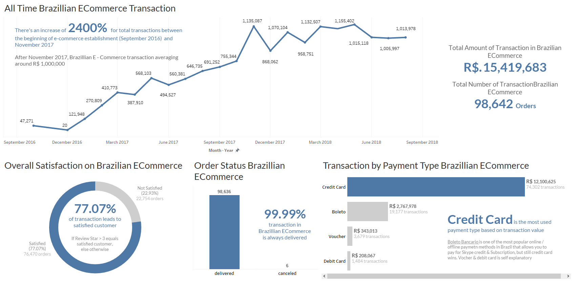
FINDINGS & SOLUTION
TABLEAU SNEAKPEEK 1

Slide 27
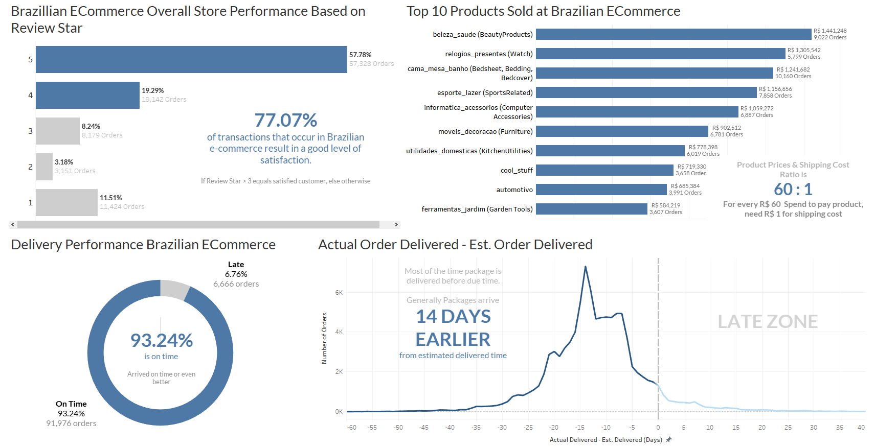
FINDINGS & SOLUTION
TABLEAU SNEAKPEEK 2

Slide 28
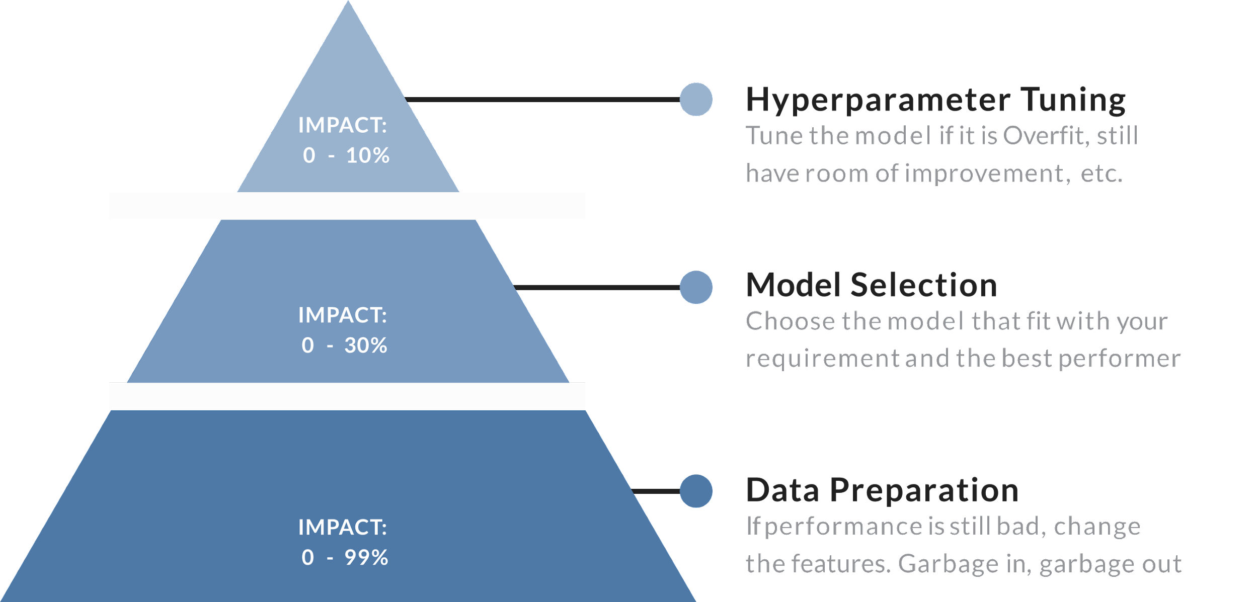
PYRAMID OF MODEL IMPROVEMENT
Sources : Ultimate Career Guide as a Data Scientitst – Agil Haykal

Slide 29
MODELING WORKFLOW
OVERALL MACHINE LEARNING PROCESS
DATA
CLEANING
PRE
PROCESSING
MODELING
HYPERPARAM TUNING
IMPLEMENT
THE MODEL
Check for duplicate data & missing values
Label the data for machine learning
Translate the review_comment_message from Portugese to English
Convert emoji into text
Standardize the review_comment_message (Lower, remove contraction, … , lemmatize)
Understanding the review_comment_message through ngram analysis & document length
Try 3 different models (Logreg, Naïve Bayes, XGBoost) with resampling method (SMOTE & NearMiss) to see which 1 give the best results
Hyperparameter Tuning result, ROC AUC Graph, and other metrics graph
Understand what kind of words that make a review comment message positive or negative (Feature importance)
If you have new review comment message (Ecommerce review comment message), you can try to use our model to classify the review comment message (Is it positive or negative sentiment?)

Slide 30
MACHINE LEARNING PROCESS
Preliminary Information
In this process We do several things below :
Using pipeline to combine text pre-processing (into DTM) and model
Using cross validation to validate the model, cv method that we used is stratifiedKFold with n_splits = 10.
Metrics that we used are ROC AUC (secondary metrics f1 score)
Hyperparameter Tuning
Machine Learning Preparation
Data cleaning (missing value, duplicate value)
Labelling the data based on given star (review), in which star > 3 => positive sentiment and star ≤ 3 => negative sentiment
Pre-processing 1 the review comment message :
Translating the corpus from Portuguese to English
Convert emoji into text
Pre-processing 2, standardized the review comment message
Lowercase, remove [contraction, numbers, punctuation, whitespace, stopwords], lemmatize
Understanding our review comment message (positive & negative response) based on frequency (1 – gram, bigram, trigram)
Split the data into train validation set & test set (80:20)

Slide 31
MACHINE LEARNING PROCESS
Machine Learning
Compare models using cross validation and test data (Model Selection)
Base model (Logistic Regression, Multinomial Naïve Bayes, XGBoost)
Base model + resampling (Handling Imbalance)
Choose the best model, try to tuned it to check if the model can be improved (Hyperparameter Tuning)
Try to adjust the threshold (Handling Imbalance)
Model performance based on chosen metrics
Feature importance (words that have high coefficient to classify whether our review comment message is positive response or negative response)
Implementation (try using our model to classify new review comment message)

Slide 32
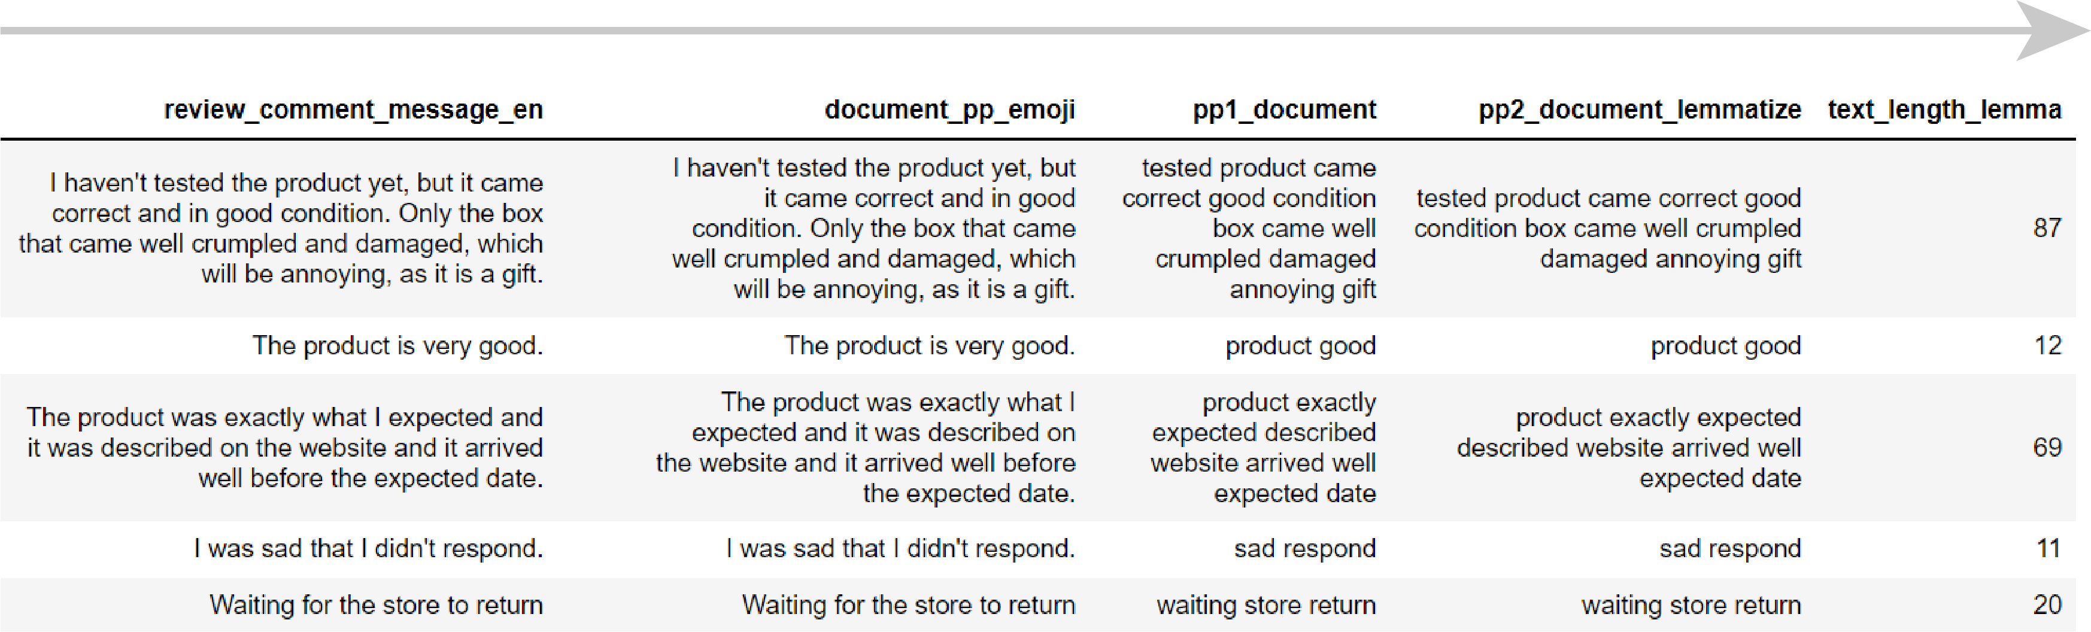
FINDINGS & SOLUTION
TEXT PROCESSING
PREPROCESSING FLOW
Here is what the original text should look like
Note that it has been translated from Portuguese to English beforehand
Emoji is replaced into a predetermined terms e.g. ‘satisfied’ and ‘dissatisfied’ or removed
Satisfied 😚 😘 😁 😀 😚 😆
Dissatisfied 😡 😕 😣 😠 😓 🤔
Removing
Contraction
Numbers
Punctuation
Whitespace
Stopwords
Turning each words into their lemma i.e. dictionary form

Slide 33
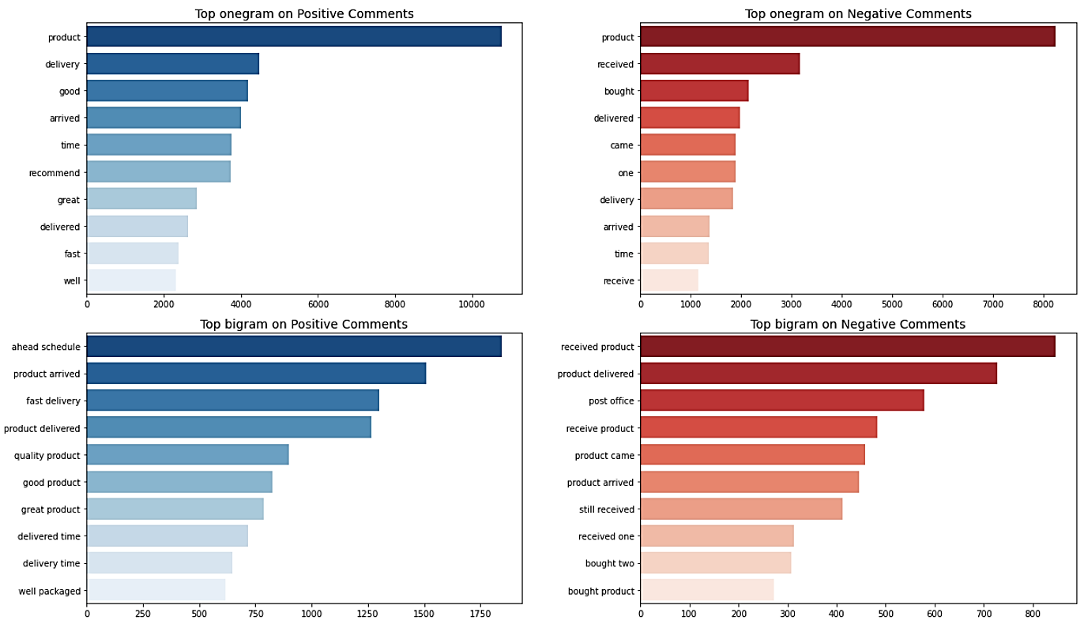
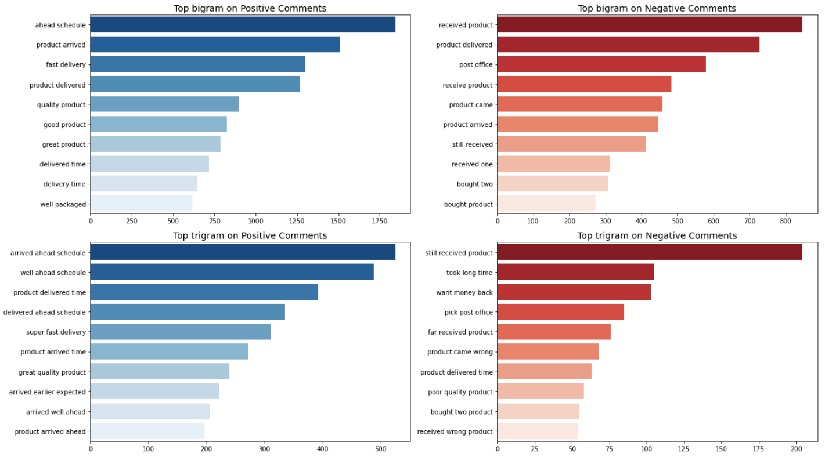
FINDINGS & SOLUTION
MOST FREQUENT 1 WORD & 2 WORDS (1 GRAM, BIGRAM) ON REVIEW COMMENT MESSAGE

Slide 34

FINDINGS & SOLUTION
MOST FREQUENT 3 WORDS (TRIGRAM) ON REVIEW COMMENT MESSAGE

Slide 35
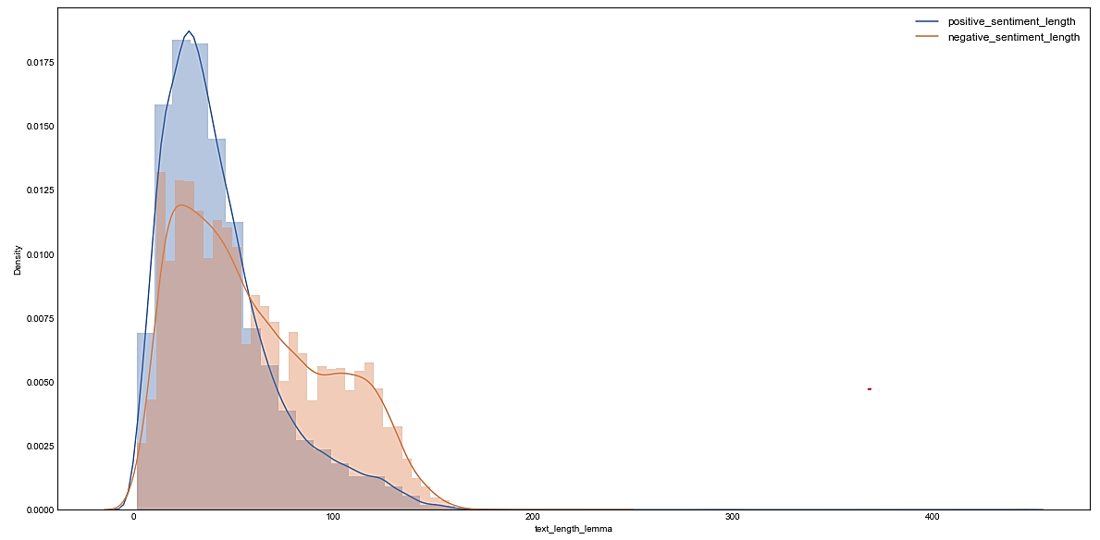
FINDINGS & SOLUTION
REVIEW COMMENT MESSAGE LENGTH (LEMMATIZE)
Overall data show that negative review comment message tend to be longer than positive review comment message
Positive sentiment
“The product arrived on time, perfect!”
Negative sentiment
“I haven't tested the product yet, the box that came well crumpled and damaged, which will be annoying, as it is a gift.”

Slide 36
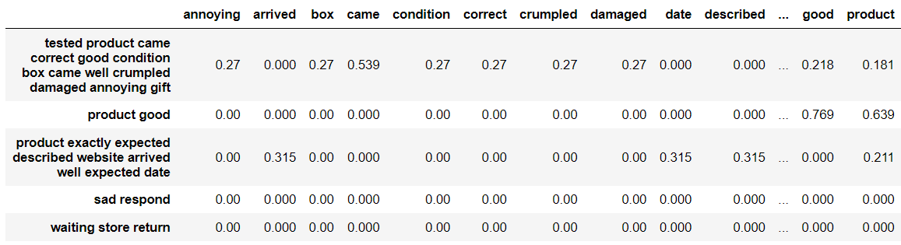
FINDINGS & SOLUTION
DOCUMENT-TERM MATRIX
TfidfVectorizer()
✂️
DOCUMENT-TERM MATRIX
Cut the features!

Slide 37
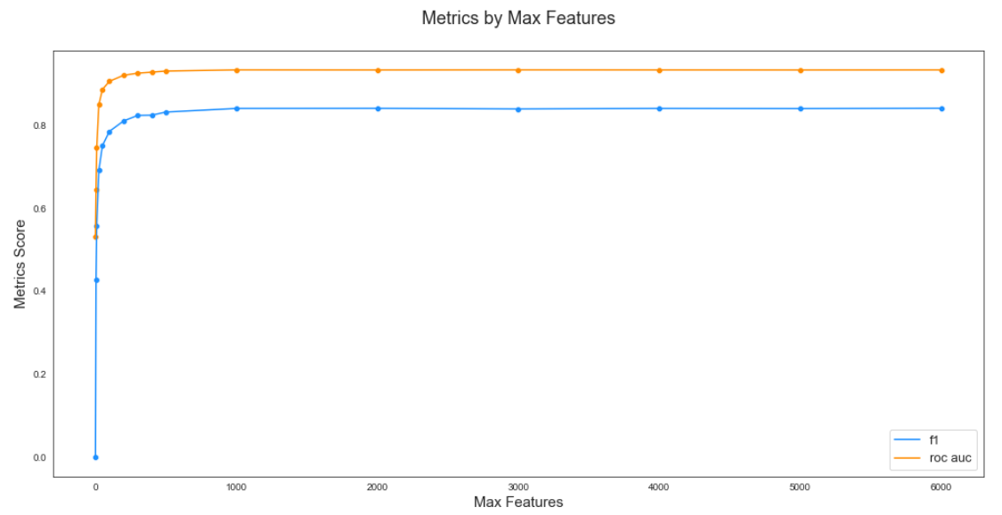
FINDINGS & SOLUTION
MAX FEATURES FOR TF-IDF (ALL FEATURES = 7910)
We can see that after 1000 features, there’s no significance improvement on our metrics, so we need not to use all the features.
Max features for TFIDF that’ll be used : 2500

Slide 38
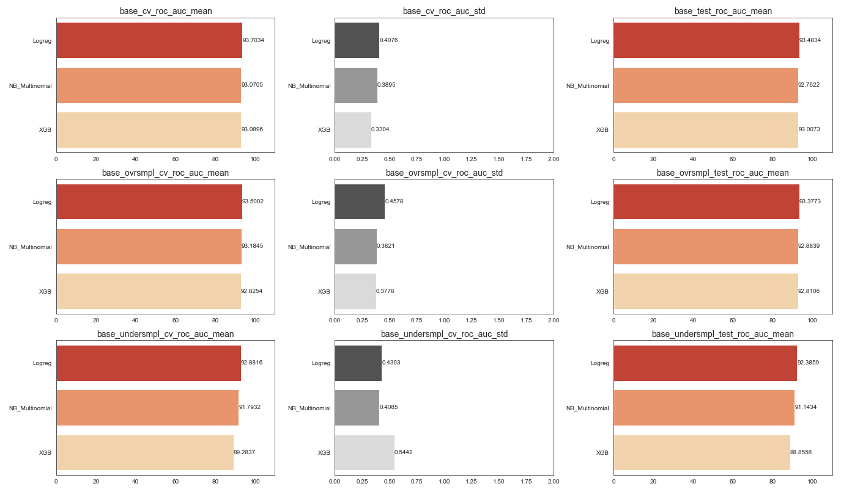
FINDINGS & SOLUTION
ROC AUC FROM SEVERAL ALGORITHM + RESAMPLING METHOD

Slide 39
FINDINGS & SOLUTION
ROC AUC FROM SEVERAL ALGORITHM + RESAMPLING METHOD

Slide 40
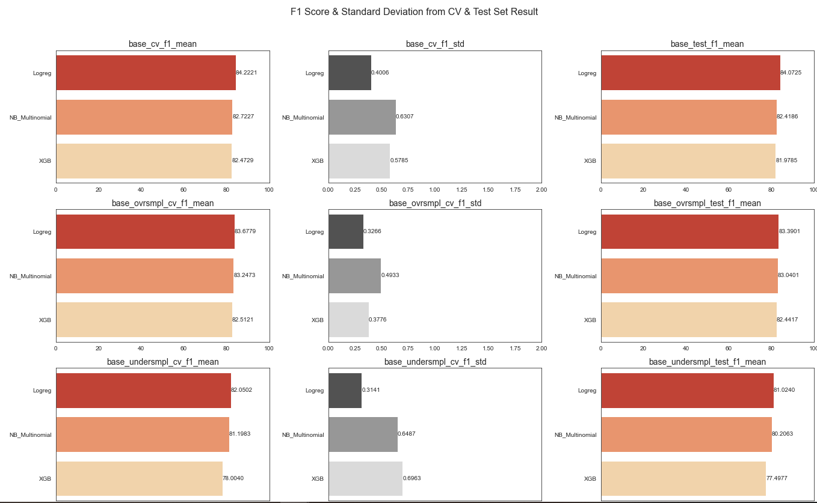
FINDINGS & SOLUTION
F1 SCORE FROM SEVERAL ALGORITHM + RESAMPLING METHOD

Slide 41
FINDINGS & SOLUTION
F1 SCORE FROM SEVERAL ALGORITHM + RESAMPLING METHOD

Slide 42
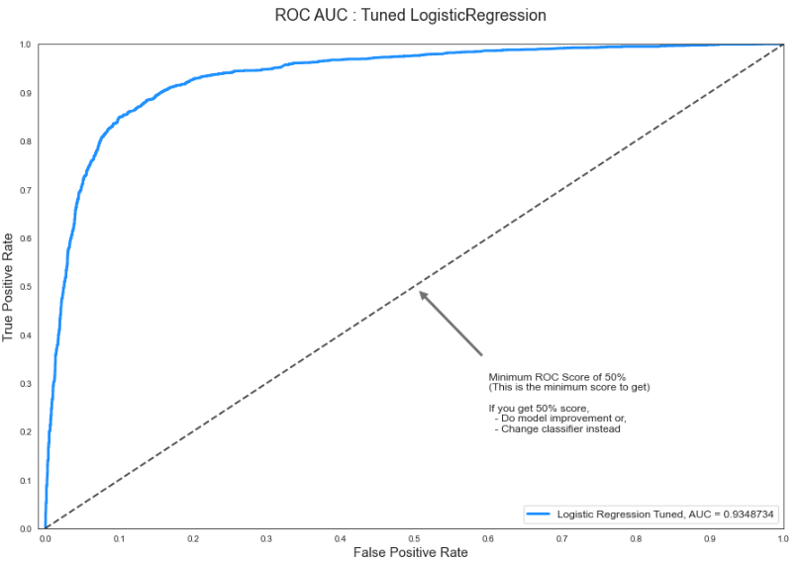
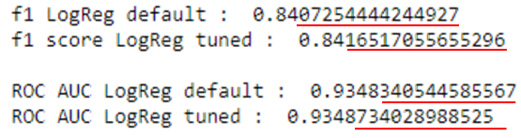
FINDINGS & SOLUTION
HYPERPARAMETER TUNING & ROC AUC GRAPH
TUNING RESULT

Slide 43
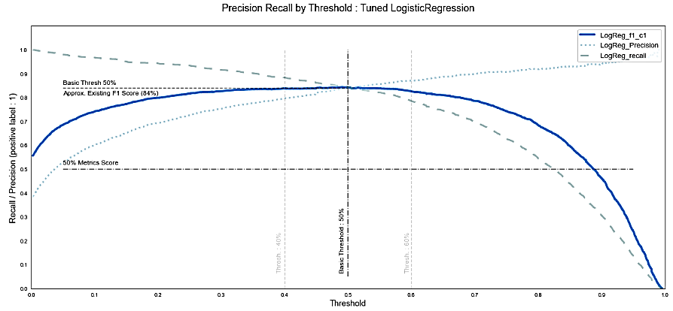
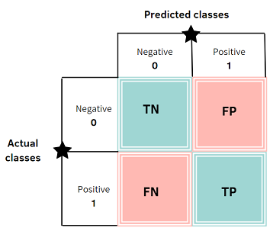
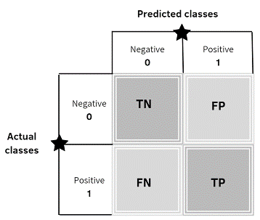
FINDINGS & SOLUTION
HANDLE IMBALANCE BY ADJUSTING THRESHOLD & CLASSIFICATION REPORT
PRECISION
FPR
TPR
RECALL

Slide 44
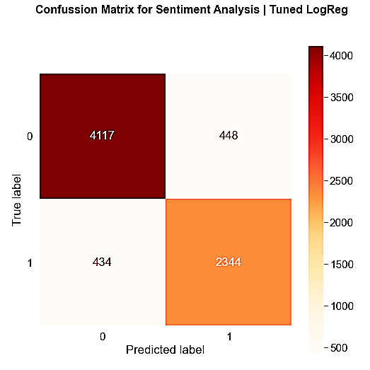
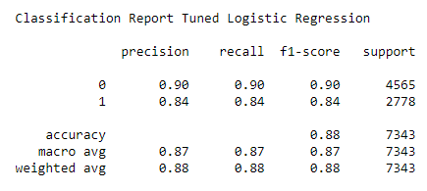
FINDINGS & SOLUTION
MODEL PERFORMANCE (TOTAL DATA TEST SAMPLE : 7343)
CLASSIFICATION REPORT
Based on the output above based on the test set, our model is well performed (can be trusted and reliable)

Slide 45
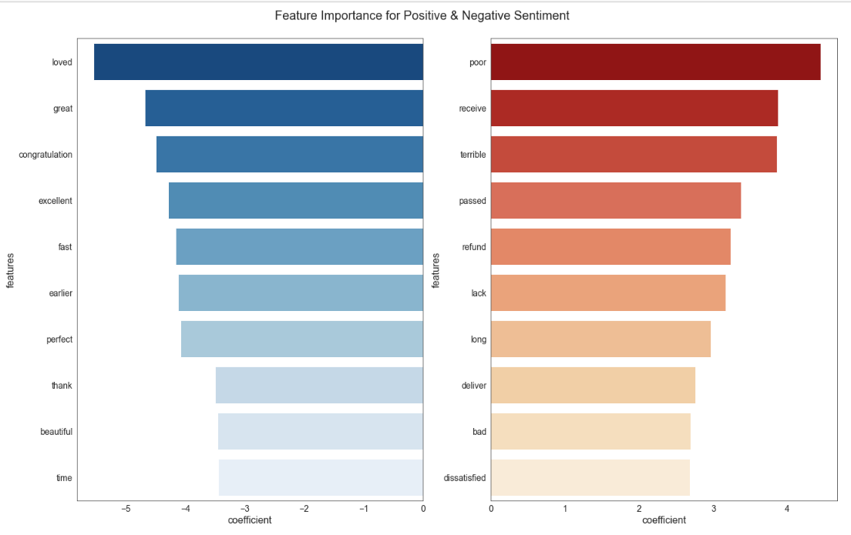
FINDINGS & SOLUTION
FEATURE IMPORTANCE
The word "dissatisfied" is a made word to interpret emoji.
In the jupyter notebook, there’s a defined function consist of dictionary of emoji that express “satisfied customer”, “dissatisfied customer”, and the thing that we can’t interpret (convert the emoji as “”)

Slide 46
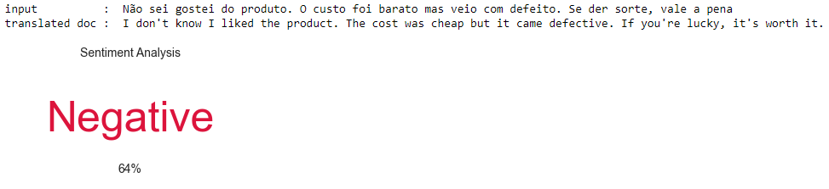
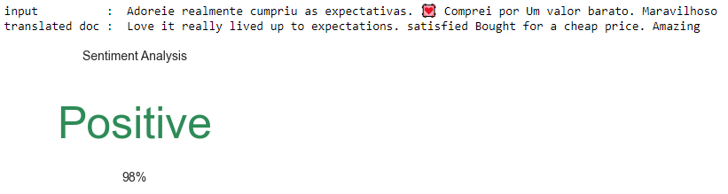
FINDINGS & SOLUTION
IMPLEMENTATION

Slide 47
CONCLUSION & RECOMMENDATION
FINAL PROJECT
Brazilian E-Commerce Public Dataset by Olist
Job Connector Data Science Video Learning
ALPHA TEAM
ALFIAN (JCDSVL-005-013)
OWEN AGITZA (JCDSVL-005-049)

Slide 48
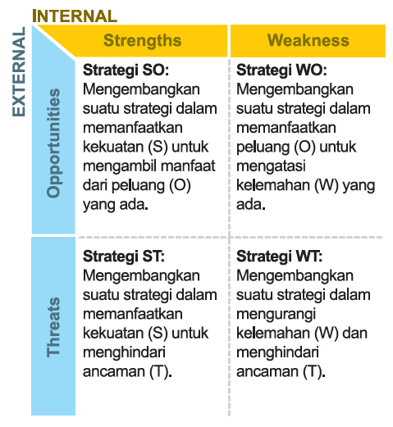
CONCLUSION & RECOMMENDATION
WHY SENTIMENT ANALYSIS
Olist now understand customer response to the seller in the platform
By understanding positive response, Olist can determine what are the things that can be maintained to preserve the positive response
By understanding the negative response, they can determine what the things need to be improved on
No need to classify the review comment message manually. Can use the model that we made
With the same approach in the notebook, we can understand competitor pros & cons. By understanding Olist competitor & learn from it, Olist can keep improv their services
Sources : Suanda, B., 2016. Advanced & Effective Project Management, Panduan Lengkap Bagi Praktisi Manajemen Proyek Profesional. Jakarta: PP Concstruction & Investment.

Slide 49
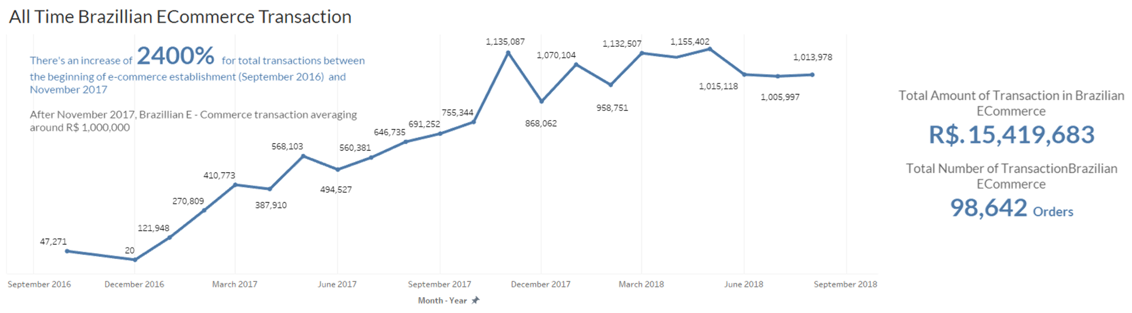
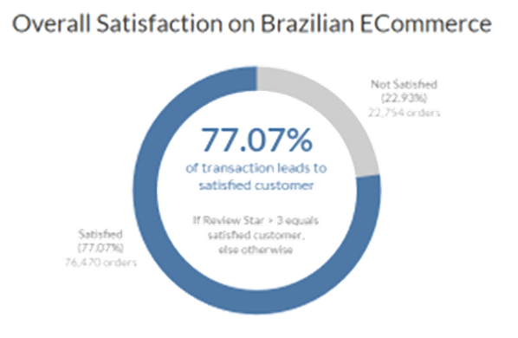
CONCLUSION & RECOMMENDATION
OVERALL BUSINESS
Positive transaction trend in Brazilian Ecommerce can indicate several things as follows:
People like using the platform
More and more people start using Olist
Credit Card is the most used payment option in the Brazilian Ecommerce
Almost all customer based on states have a good proportion of positive sentiments

Slide 50
CONCLUSION & RECOMMENDATION
REVIEWS, CUSTOMERS, PRODUCTS (1/2)
41.30% of orders are not receiving comments while the rest do (58.70%) . After statistical test, it is inferred that customers that do not comment might have a give statistically different review score than those who do (Potentially higher score)
Negative sentiment comment tend to be longer than the positive one. This is normal because when the product is already good there's no complain
Overall, most orders have a review score of 5 (57.78%) , followed by 4 (19.29%) and closely by 1 (11.51%) . Meanwhile, for review score of 2 and 3 constitute no more than 12% . This data suggests that the customers tend to skip the in between score (2 and 3) right to the extremes if the order performance is poor. If the order performance is good, going straight to 5

Slide 51
CONCLUSION & RECOMMENDATION
REVIEWS, CUSTOMERS, PRODUCTS (2/2)
The insight ngrams analysis suggests that the most important factor in customer sentiment is order delivery timeliness. Both positive and negative reviews are centered around the delivery. The next potential factor is product quality unfortunately cannot be analyzed using the current data.

Slide 52
CONCLUSION & RECOMMENDATION
PRODUCTS DELIVERY
There seems to be no difference in customer sentiments in terms of delivery path (i.e. distance). This suggests that in the end, distance may not play part in the overall customer sentiment, as long as the delivery process is under control
Overall, the delivery timeliness performance of Olist is good (±90% orders is on time), with items delivered 14 days before estimated time on average

Slide 53
CONCLUSION & RECOMMENDATION
RECOMMENDATION FOR BUSINESS (1/2)
Olist could expand further to the northern part of Brazil since it is largely still available for expansion
The business should maintain and improve upon the order delivery, may it be in delivery services or logistics, since it is the most important factor in customer sentiment
Olist should implement customer service to accommodate for complain management. This way, the severity of negative sentiment cases could be minimzed

Slide 54
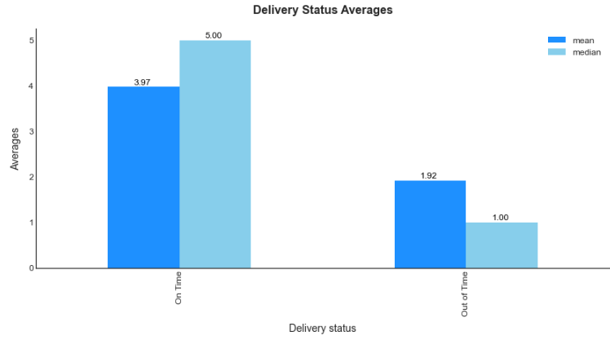
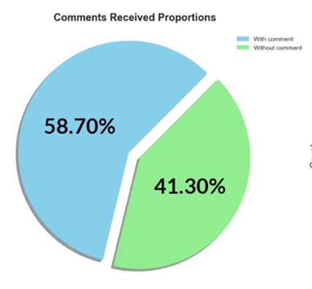
CONCLUSION & RECOMMENDATION
RECOMMENDATION FOR BUSINESS (2/2)
Olist should add delivery service/logistics as a feature in their database. This is a crucial feature that is directly related to order delivery and as such can unveil important business insights
Olist could consider to incentivize giving reviews, since more reviews mean more insights and improvements to be gained. Over 40% orders are stll without comment

Slide 55
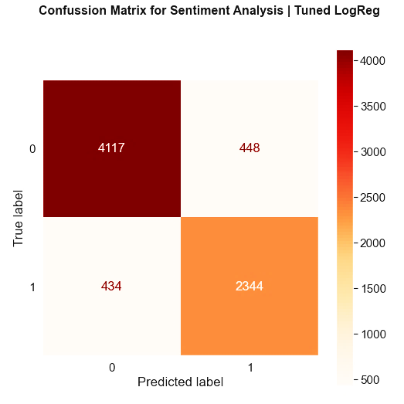
CONCLUSION & RECOMMENDATION
RECOMMENDATION FOR OUR MODEL
Can try another algorithm to see if there’s any algorithm that can performed better than the models that area available in the notebook
Try labelling using Vader to label our review comment message
Trace the data that is still wrongly predicted to find out the cause of the wrong prediction and become the basis for future model improvement

Slide 56
THANK YOU !
FINAL PROJECT
Brazilian E-Commerce Public Dataset by Olist
Job Connector Data Science Video Learning
ALPHA TEAM
ALFIAN (JCDSVL-005-013)
OWEN AGITZA (JCDSVL-005-049)

